Slide 1
Enterprise Resource Planning

Slide 2
Internship Program
LOCATION at INFICLOUD Private Limited, Belgaum
Internship Supervisor : Mr. Shankar Batlad
Duration from February 04, 2019 to March 08, 2019
Domain – Web Technology and Development
Under the Guidance of
Prof. Savita Bakare
Dept. of CSE

Slide 3
Hello!
I am Ajaykumar Majukar
I am here because I love to give presentations.
You can find me at ajaymajukar@gmail

Slide 4
1. INFICLOUD
About the Company

Slide 5
Start-up recognized by Government of India
Started as a small private firm in the year 2014 Mr. Shankar Batlad
Main motto is to provide customized software solutions, Training and services
Working on cutting edge technologies
like,
Cloud Computing
Data Analytics

Slide 6
ERP
Enterprise resource planning (ERP) is the integrated management of core business processes, often in real-time and mediated by software and technology.

Slide 7

2. DJANGO
The web framework for perfectionists with deadlines

Slide 8
Django is a high-level Python Web framework that encourages rapid development and clean, pragmatic design.

Slide 9



Let’s Meet Django
Ridiculously fast.
Django was designed to help developers take applications from concept to completion as quickly as possible.
Reassuringly secure.
Django takes security seriously and helps developers avoid many common security mistakes.
Exceedingly scalable.
Some of the busiest sites on the Web leverage Django’s ability to quickly and flexibly scale.

Slide 10
Our process is easy
User
Django
URL
View
Model <--> Template
1
2
3
4
5

Slide 11
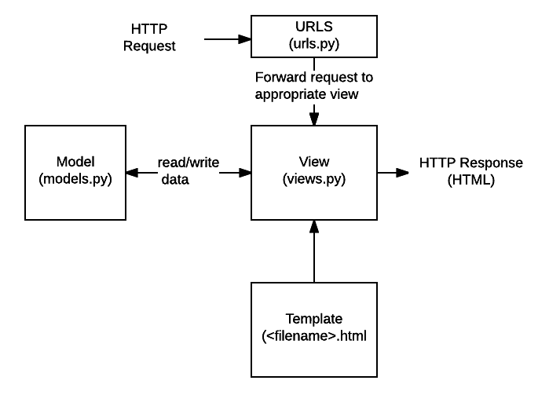
Flow Chart DJANGO PROCESS.

Slide 12
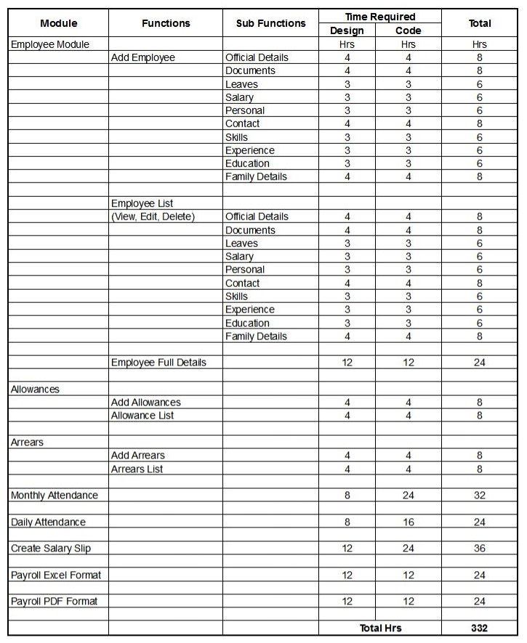

Slide 13
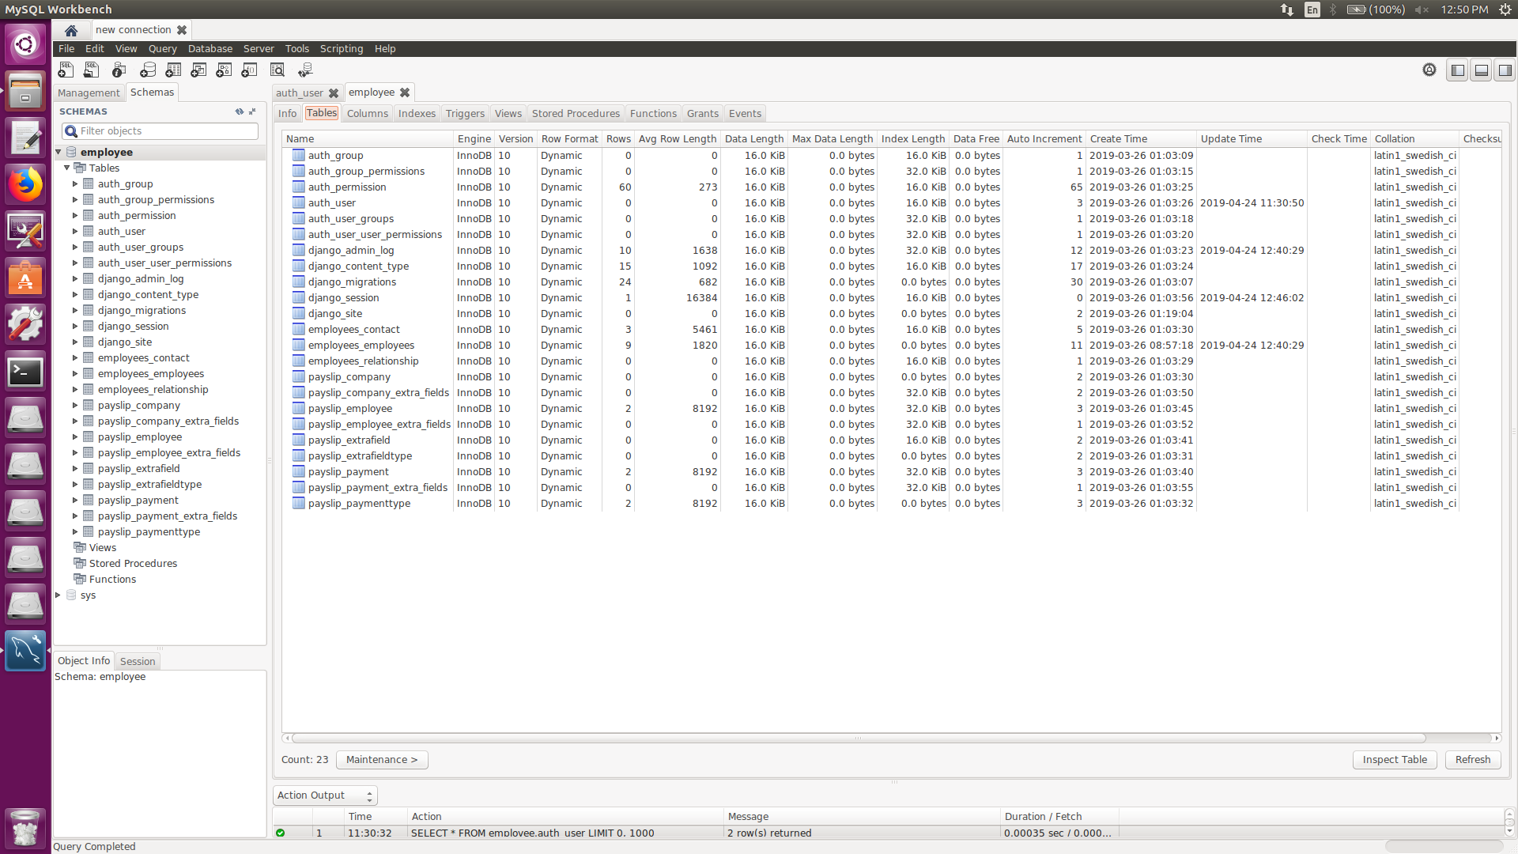

Slide 14
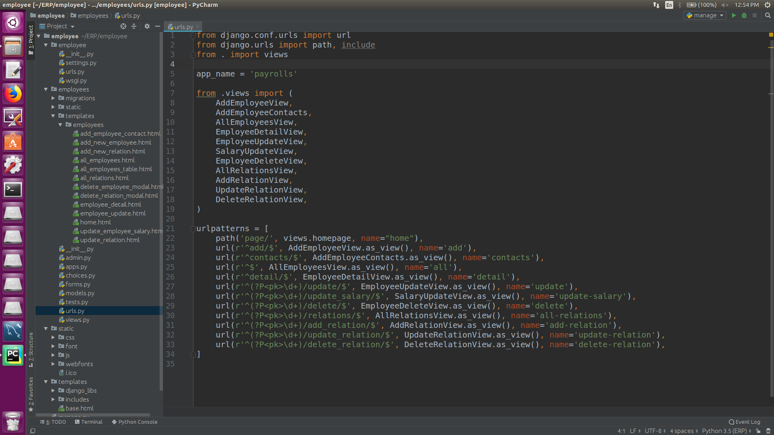

Slide 15
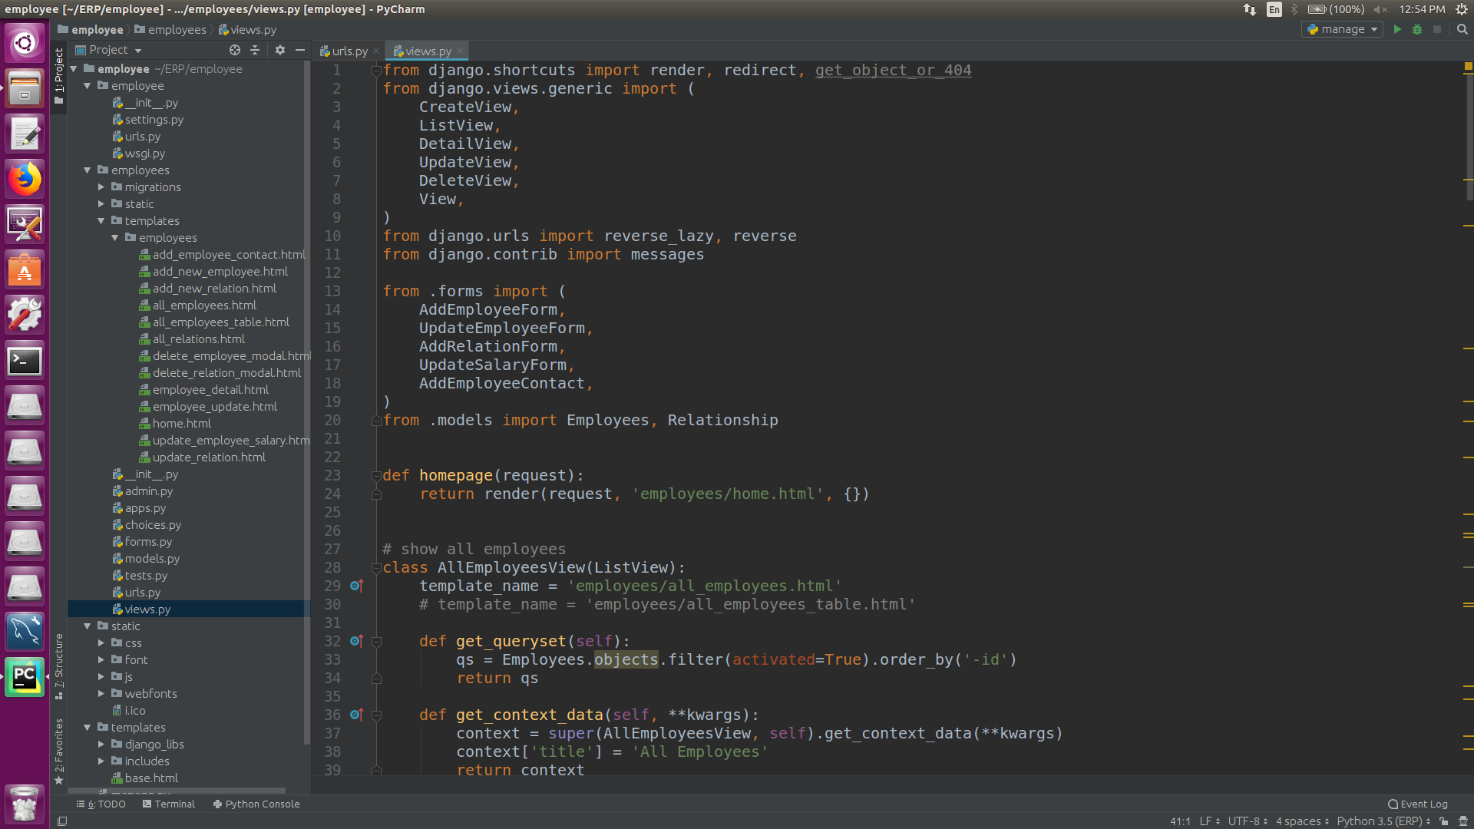

Slide 16
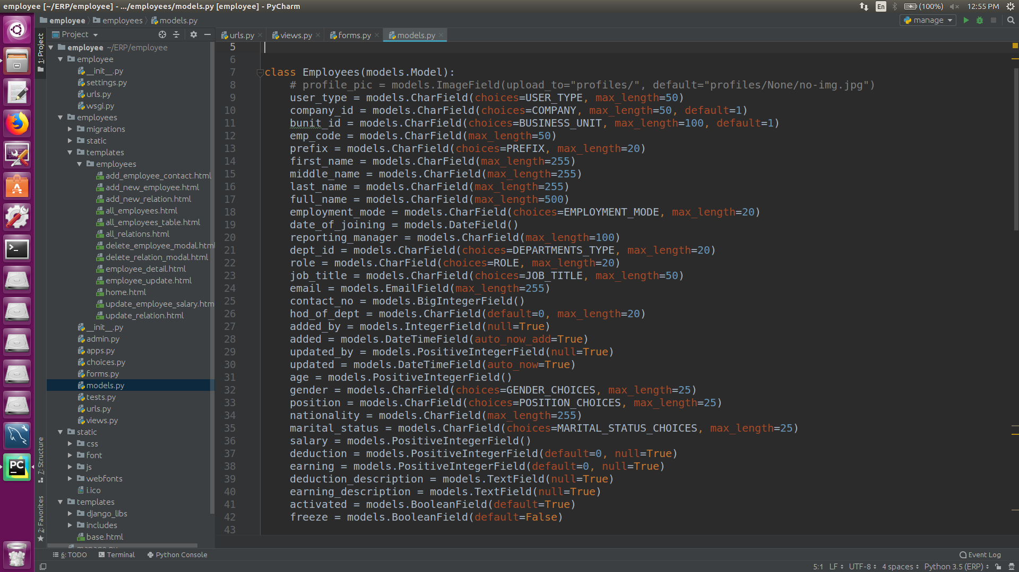

Slide 17
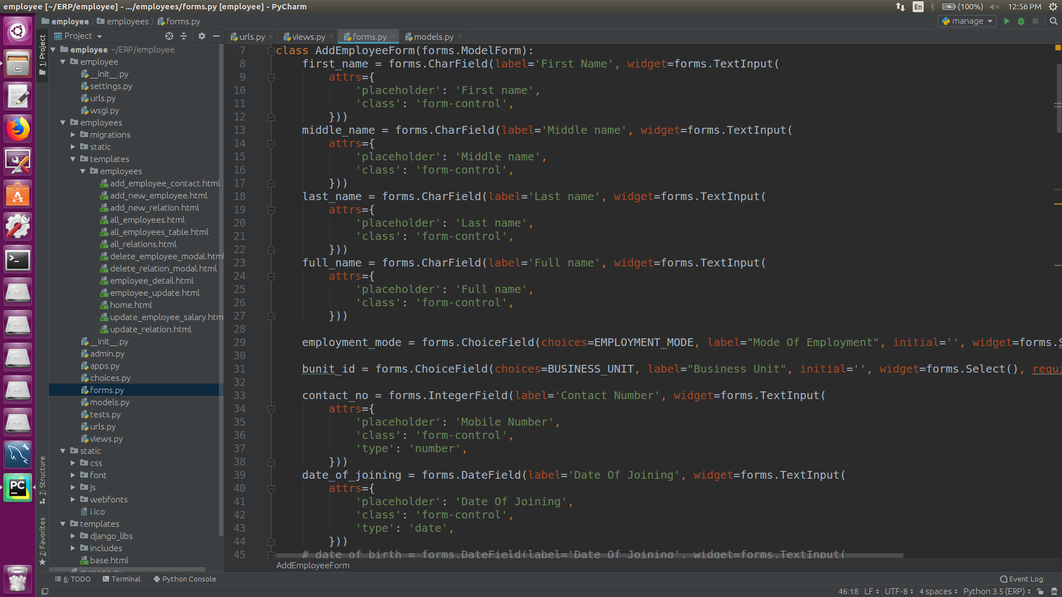

Slide 18
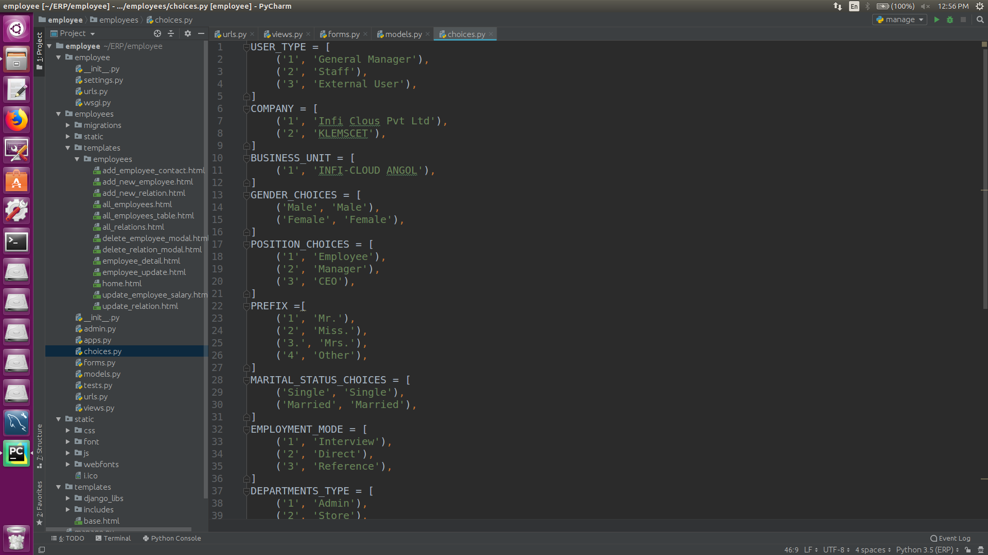

Slide 19
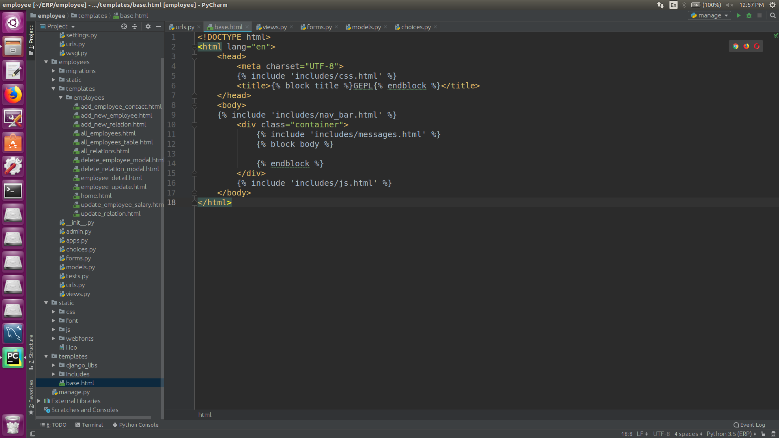

Slide 20
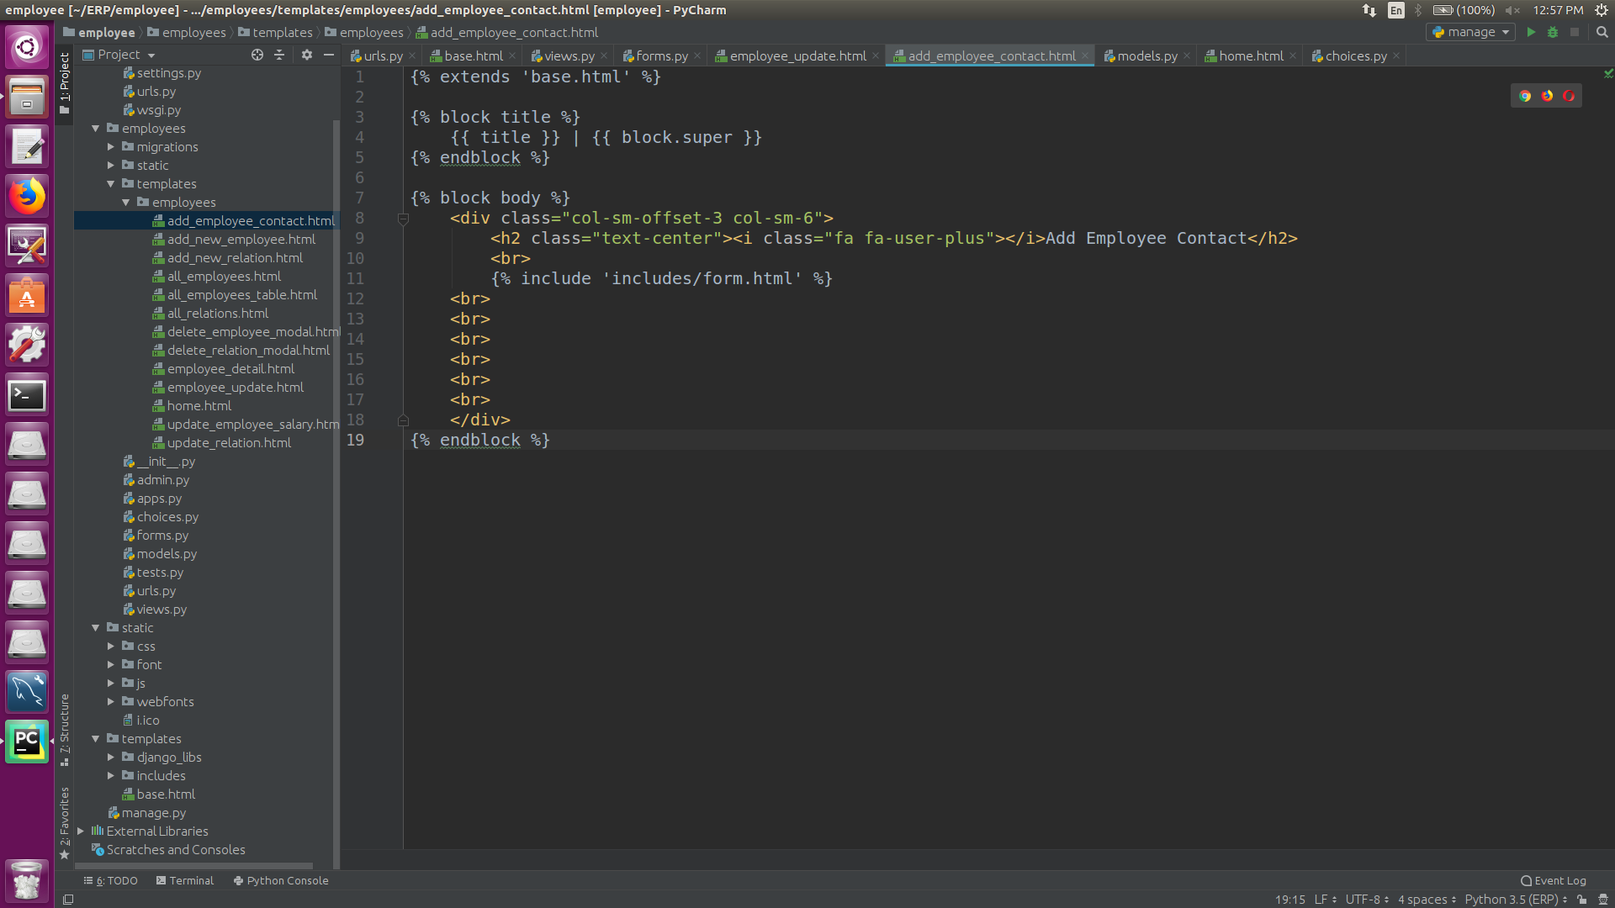

Slide 21
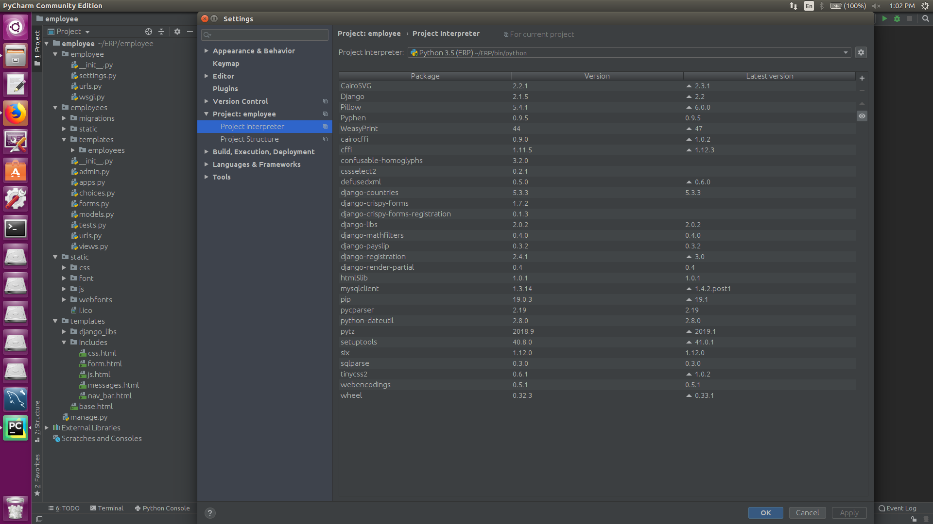

Slide 22
Thanks!
Any questions?
You can find me at:
ajaymajukar@gmail.com

